Slide 1
Synergism through Collaboration: The History of Open Textbook Adoption at Marshall University
WV Professional Development Week
Larry Sheret
Marshall University Libraries & Online Learning

Slide 2
Textbook Prices Decline 1/1/2017 thru 6/31/2019
National textbook prices have dropped 26% since 2017, according to a new report by campusbooks.com.
The national decrease in price is the first in years as the Bureau of Labor Statistics found textbook cost increased 88% between 2006 and 2016.
http://loyolaphoenix.com/2019/08/textbook-prices-drop-for-first-time-in-a-decade/

Slide 3
Stakeholders
Marshall Administration
Student Government Association (SGA)
Faculty
Bookstore (Follett)
Libraries & Online Learning
Center for Teaching and Learning (CTL)
The State of West Virginia

Slide 4
Lower Cost Precursors to Free Textbooks
2010: Affordable Textbook Committee was formed to investigate ways to mitigate the rapid rise in textbook costs. The nascent open textbook movement was not on anyone’s radar.
-Adopting rentable titles
-Using digital text, if more affordable
-Encourage continual usage of text (to increase the used book availability)
-Encourage using bundles only if all components are being used. Examples of affordable bundles are the nursing bundles.
-Encouraging faculty to submit timely textbook adoptions. This will increase the used book availability and rental selection
-Use older editions if sufficient quantities are available.
-Currently reviewing/discussing a Follett Access program.
Notes:
Follett ACCESS, a powerful program that enables colleges and universities to deliver all course changes (textbooks, lab kits, supplies, etc.) as part of tuition and course charges.

Slide 5
Marshall Administration
2010 Formed the Affordable Textbook Committee
2018 & 19 Provided bonus funds to Departments that adopted an Open Textbook (Chemistry and Math)
2020 Paid $250 stipends to 35 faculty who attended an Open Textbook Workshop and submitted a review to the Open Textbook Library

Slide 6
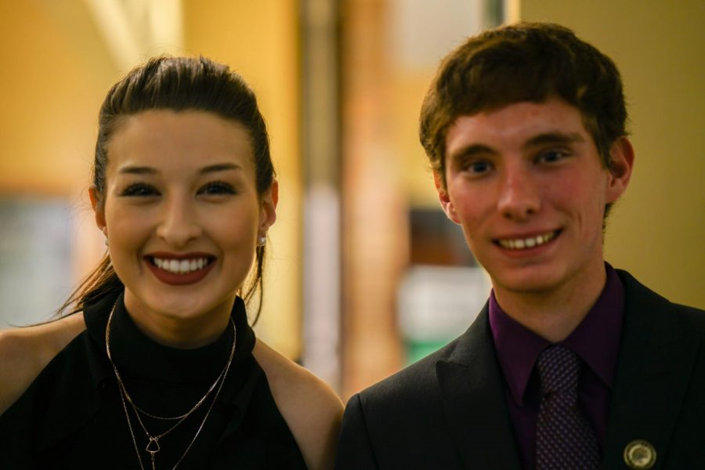
SGA 2018/2019
Hannah Petracca and Hunter Barclay , 2019
Partnered with Bookstore to find HIGH IMPACT CLASSES based on enrollment and textbook cost
Partnered with Administration to add “Low cost” textbook icon to course catalog
Partnered with Dept. of Finance to reward depts that adopt OER.
Marketed Open Textbooks

Slide 7
Cost Comparison
How To Make One:
Acquire the bookstore’s price
Compare that price to other platforms
Delve into affordable alternatives
Calculate cost savings

Slide 8
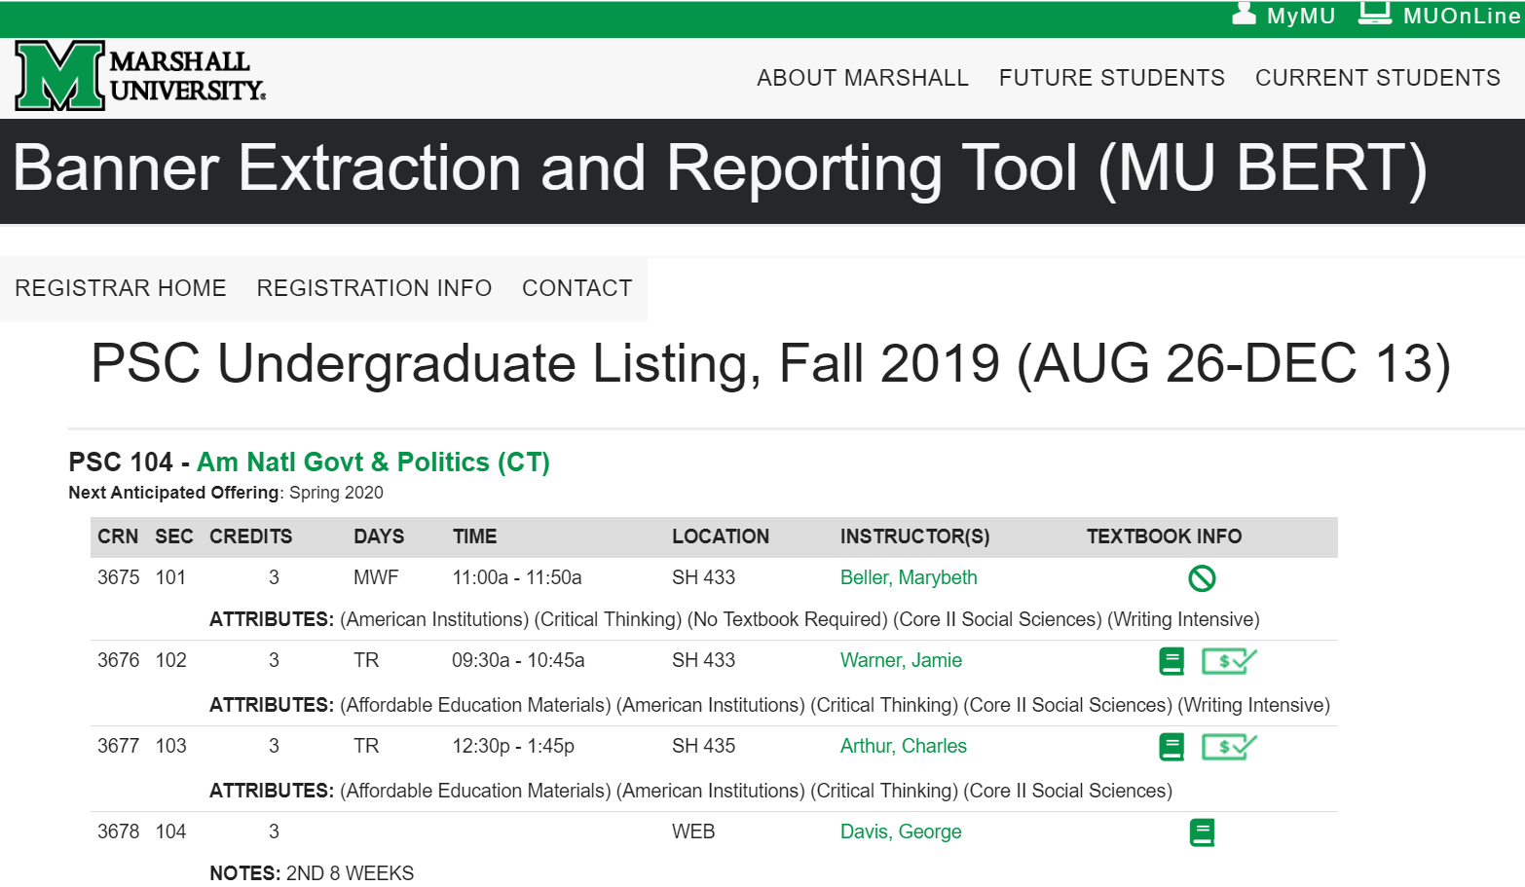
Registration Icons
No Textbook Required
Affordable Option
By Hannah Petracca and Hunter Barclay, 2019

Slide 9
High Yield Courses
SOC 200
MTH 121
MTH 130
BSC 104
BSC 105
PSY 201
ACC 215
ACC 216
PHY 201
PHY 203
HS 220
BSC 120
BSC 121
BSC 227
BSC 228
MTH 102
ECN 250
ECN 253
THE 112
CMM 207
MUS 142
MTH 127
By Hannah Petracca and Hunter Barclay, 2019

Slide 10
Math Uses OpenStax for MTH 127 & 130
F19: 629
S20: 255
Total 884

Slide 11
Chemistry Uses OpenStax for CHM 211 & 212
211 212
F18 285 98
S19 167 221
F19 324 104
S20 180 210
Total 1,589

Slide 12
What Exactly is an Open Textbook?
"5 Rs image" by David Wiley

Slide 13
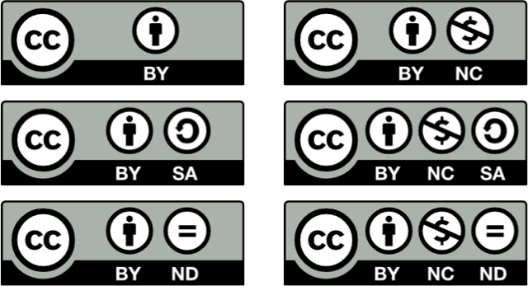
Creative Commons Licenses
Notes:
These are the 6 CC licenses. Maybe even quiz them on one or two...
Note that these licenses are used in many places, but we often don’t notice them. For instance. . . .

Slide 14
Marshall Univ. Libraries & Online Learning
2017 (Fall) Assoc. Dean of Libraries on sabbatical to research OER
2018 (Fall) SGA and Library begin collaboration
2019 (January) Scholarly Communications & OER Librarian position
2019 (February) Marshall Digital Scholar Specialist position supports OER
2019 (April) MU joins the Open Textbook Network
2019 (May) OER LibGuide published
2019 (August) OER Workshop at iPEDS/Center for Teaching & Learning
2020 (January) Open Textbook Workshop and Paid Review (29)
2020 (March) Open Textbook Workshop and Paid Review (13)

Slide 17
Open Textbook Network
OTN Provides training, networking opportunities, open textbook resources, software to manage outreach.
Training the Trainers
OTN Google Group
Open Textbook Library
Open Textbook Review Workshops
OTN Dashboard to manage outreach to faculty

Slide 18
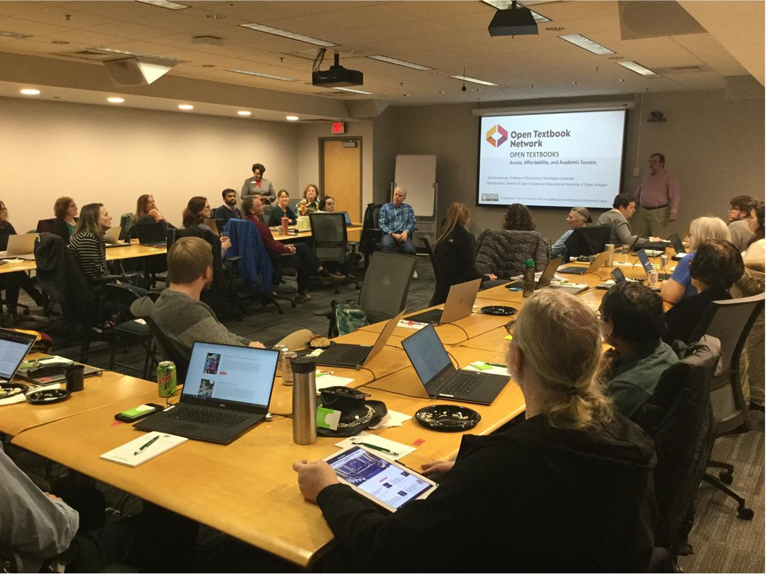
Notes:
29 faculty attended Marshall’s first Open Textbook Network Workshop & Paid Review on 1-31-2020
13 faculty attended Marshall’s second Open Textbook Workshop & Paid Review on 3-16-2020

Slide 19
Adoptions Yes 13/Maybe 19 out of 41 participants

Slide 20
West Virginia House Bill 4729 Passed March 3, 2020; in effect ninety days from passage.
AN ACT to amend and reenact §18B-10-14 of the Code of West Virginia, 1931…
(6) Encourage and incentivize the use of emerging technologies, such as electronic textbooks, online textbooks, print-on-demand services, and other open resource materials
http://www.wvlegislature.gov/Bill_Status/bills_text.cfm?billdoc=HB4729%20SUB%20ENR.htm&yr=2020&sesstype=RS&i=4729

Slide 21
To communicate further about open textbooks, contact me at
sheret@marshall.edu
Phone (303) 696-6577

Slide 22
Marshall University OER LibGuide https://libguides.marshall.edu/c.php?g=922133&p=6646180 Open Textbook Library https://open.umn.edu/opentextbooks

